Slide 1
Final Project Automatic music transcription : Polyphonic Piano Music Transcription
Group 40
陳劭傑 0756078
王昶鈞 0756612

Slide 2
Reference
[1] Sigtia, Siddharth, Emmanouil Benetos, and Simon Dixon. "An end-to-end neural network for polyphonic piano music transcription." IEEE/ACM Transactions on Audio, Speech, and Language Processing 24.5 (2016): 927-939.
[2] Boulanger-Lewandowski, Nicolas, Yoshua Bengio, and Pascal Vincent. "Modeling temporal dependencies in high-dimensional sequences: Application to polyphonic music generation and transcription." arXiv preprint arXiv:1206.6392 (2012).
[3] Boulanger-Lewandowski, Nicolas, Yoshua Bengio, and Pascal Vincent. "High-dimensional sequence transduction." 2013 IEEE International Conference on Acoustics, Speech and Signal Processing. IEEE, 2013.

Slide 3
Introduction
Automatic Music Transcription (AMT) automates the process of converting an acoustic musical signal into some form of musical notation.
The AMT problem can be divided into several subtasks: multi-pitch detection, note onset/offset detection, quantization … etc.

Slide 4
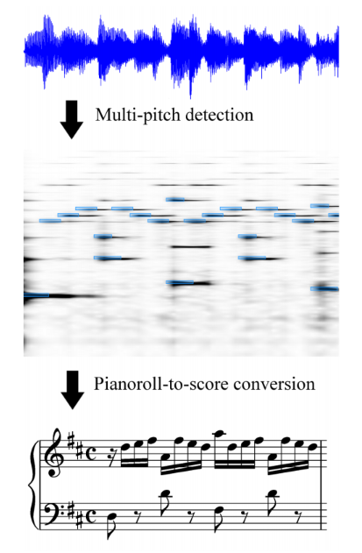
Goals and Objectives
The core problem in automatic transcription is the estimation of concurrent pitches in a time frame, also called multi-pitch detection
We implemented a Hybrid-RNN proposed by [1].
4

Slide 5

Methodology - Data Representation
A Piano song
Recorded with
realistic instrument
Music score
Song data
Ground truth

Slide 6
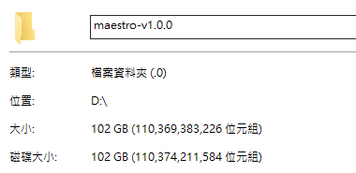
Methodology - Datasets
MAESTRO
1184 piano songs with .wav and .midi files.
Training set : 900 songs
Testing set : 284 songs

Slide 7
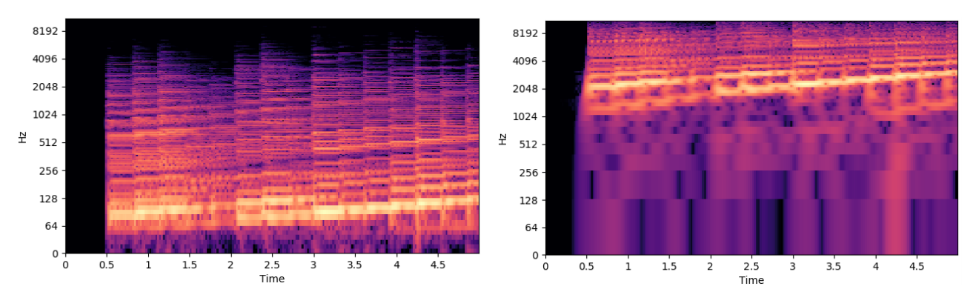
Methodology - Data Preprocessing (1/2)
Convert (wav.) file to Constant-Q transform(CQT) spectrogram, which has stretches the low frequency domain comparing with Short-Time Fourier Transform(STFT).
STFT
CQT

Slide 8
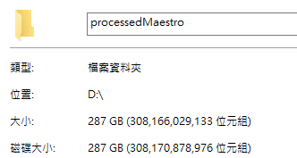
Methodology - Data Preprocessing (2/2)
To enhance the efficiency of CQT, the audio signal is first down sampled from 44.1 kHz → 16 kHz.
The hop size is 512, so we have 1/(16000 / 512) = 0.032 second per frame.
88 notes × 3 bins = 264 dimensional input vector for each frame.
C5
C4
C5
|-- 36 bins --|
130.8 Hz
261.6 Hz
523.2 Hz

Slide 9
Methodology – Hybrid structure
Acoustic model
Language model

Slide 10
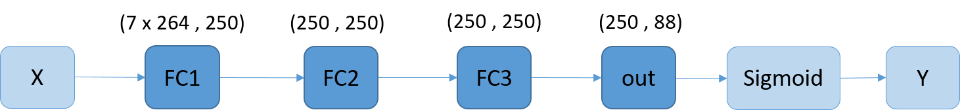
Methodology – Acoustic models
All models use Binary Cross Entropy as their loss function
DNN
LSTM

Slide 11
Methodology – Acoustic models
CNN

Slide 12
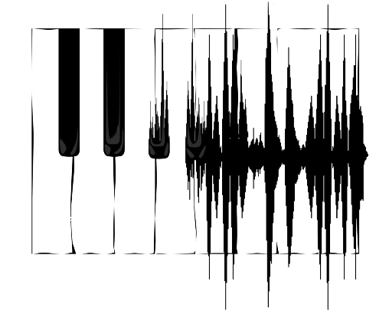
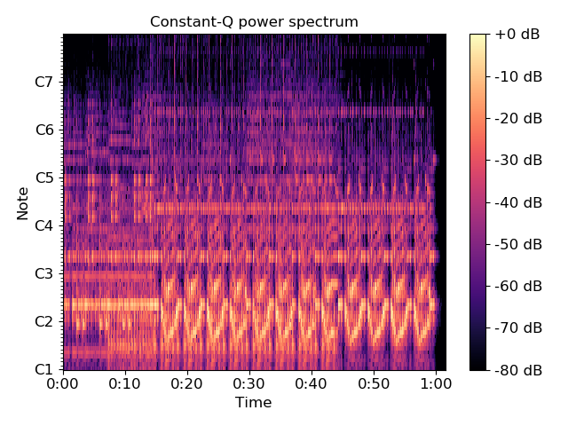
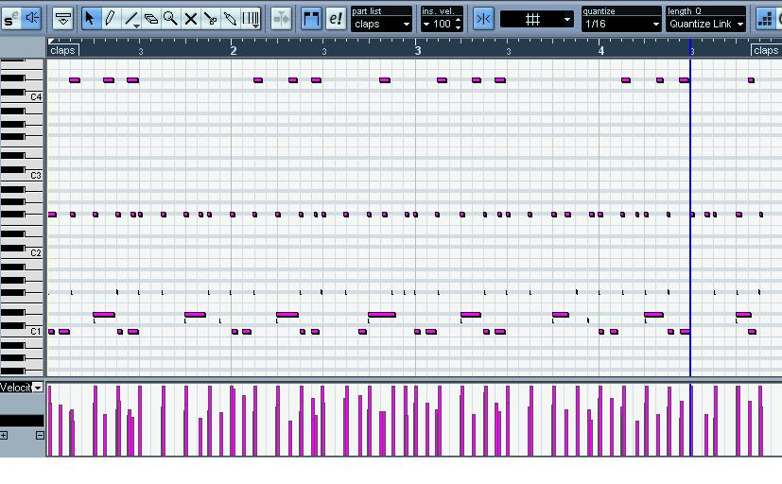
Methodology - Training
Model
Predicted result
for frame i
wav. file
spectrogram
for each frame
BCE Loss ( 88 classes )
Ground truth for frame i
corresponded midi files

Slide 13
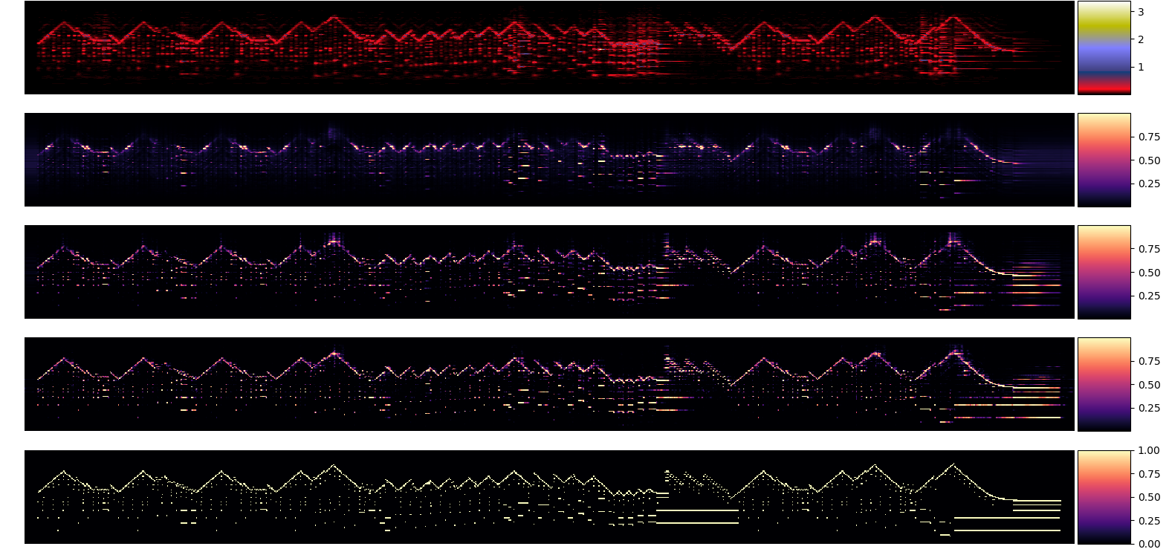
Acoustic model outputs
2017\MIDI-Unprocessed_070_PIANO070_MID--AUDIO-split_07-08-17_Piano-e_1-02_wav--2
Wav
DNN
RNN
CNN
Truth

Slide 14
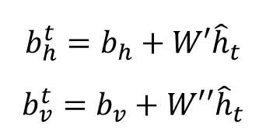
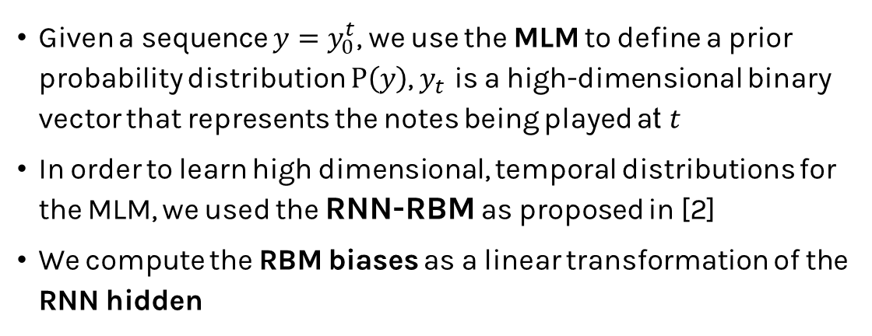
Methodology – Music Language Model
Given a sequence $y=y_{0}^{t}$, we use the MLM to define a prior probability distribution $P\left(y\right)$, $y_{t}$ is a high-dimensional binary vector that represents the notes being played at $t$
In order to learn high dimensional, temporal distributions for the MLM, we used the RNN-RBM as proposed in [2]
We compute the RBM biases as a linear transformation of the RNN hidden
$$b_{h}^{t}=b_{h}+W′{\hat{h}}_{t}$$
$$b_{v}^{t}=b_{v}+W′′{\hat{h}}_{t}$$

Slide 15
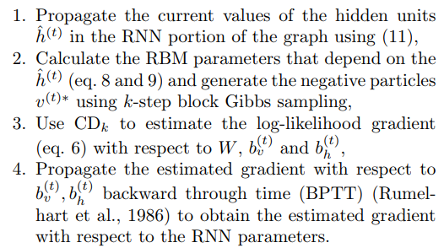
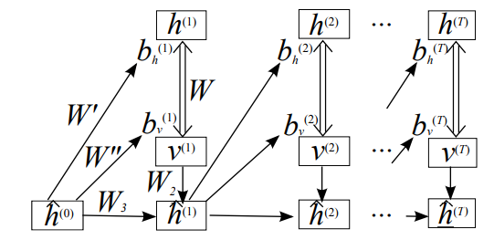
Methodology – RNN-RBM

Slide 16
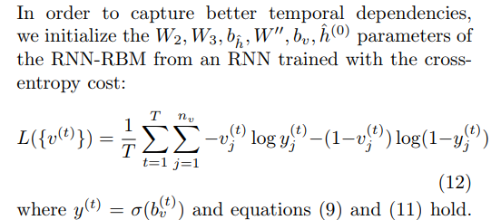
Methodology – BPTT For RNN-RBM

Slide 17
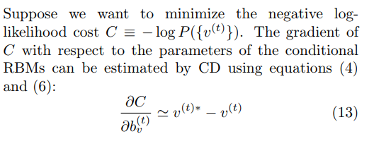
Methodology – BPTT For RNN-RBM

Slide 18
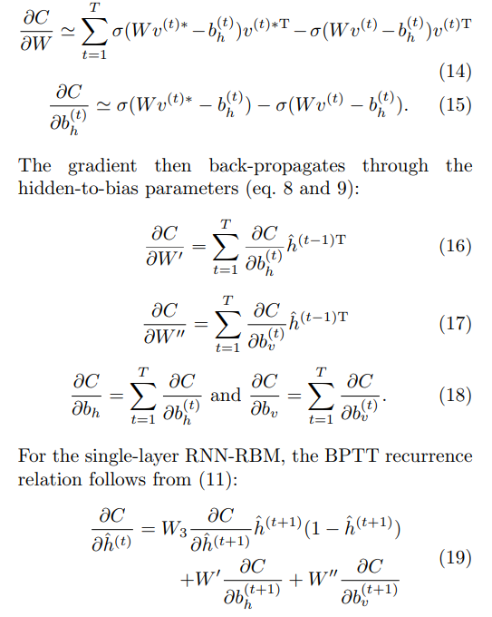
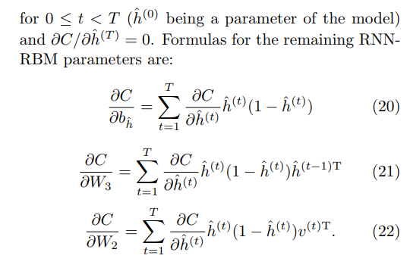
Methodology – BPTT For RNN-RBM

Slide 19
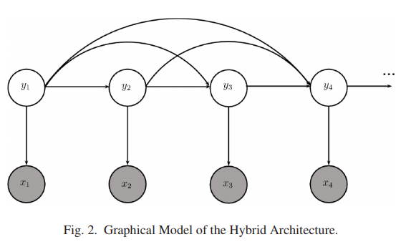
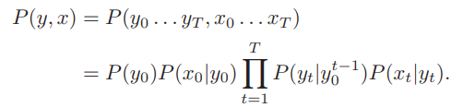
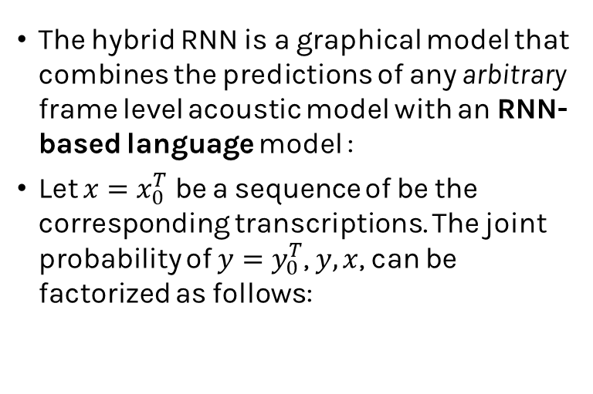
Inference
The hybrid RNN is a graphical model that combines the predictions of any arbitrary frame level acoustic model with an RNN-based language model :
Let $x=x_{0}^{T}$ be a sequence of be the corresponding transcriptions. The joint probability of $y=y_{0}^{T}$, $y, x$, can be factorized as follows:

Slide 20
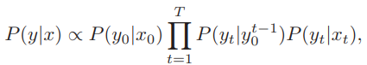
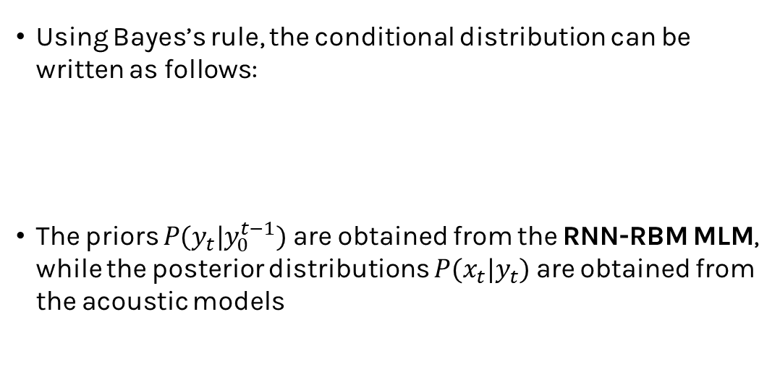
Inference
Using Bayes’s rule, the conditional distribution can be written as follows:
The priors $P(y_{t}|y_{0}^{t−1})$are obtained from the RNN-RBM MLM, while the posterior distributions $P(x_{t}|y_{t})$ are obtained from the acoustic models

Slide 21
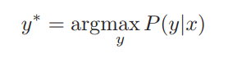
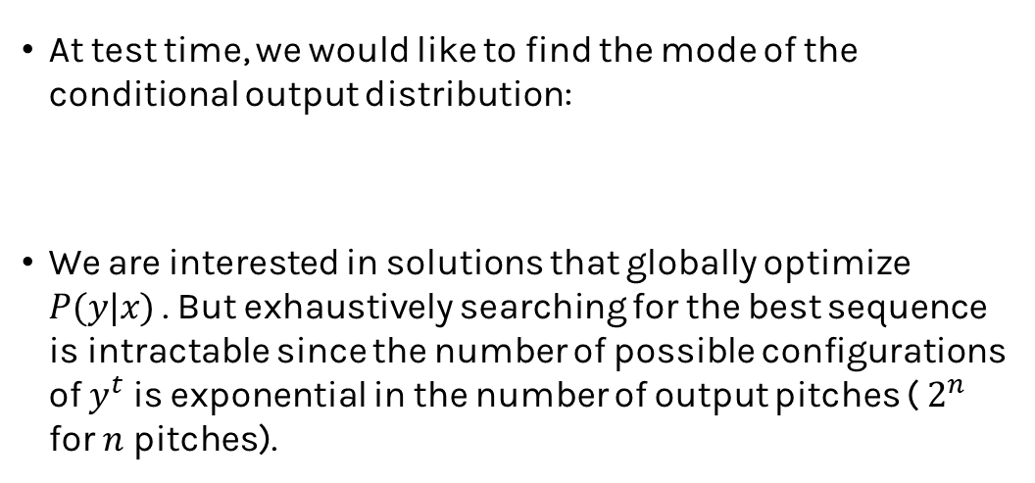
Inference
At test time, we would like to find the mode of the conditional output distribution:
We are interested in solutions that globally optimize $P(y|x)$ . But exhaustively searching for the best sequence is intractable since the number of possible configurations of $y^{t}$ is exponential in the number of output pitches ( $2^{n}$ for $n$ pitches).

Slide 22
Beam search
A graph search algorithm that is commonly used to decode the conditional outputs of an RNN.
When the space of candidate solutions is large, the algorithm can be constrained to consider only K new candidates for each partial solution in the beam.
In [3], the authors, propose forming a pool of K candidates by drawing random samples from the conditional output distribution.

Slide 23
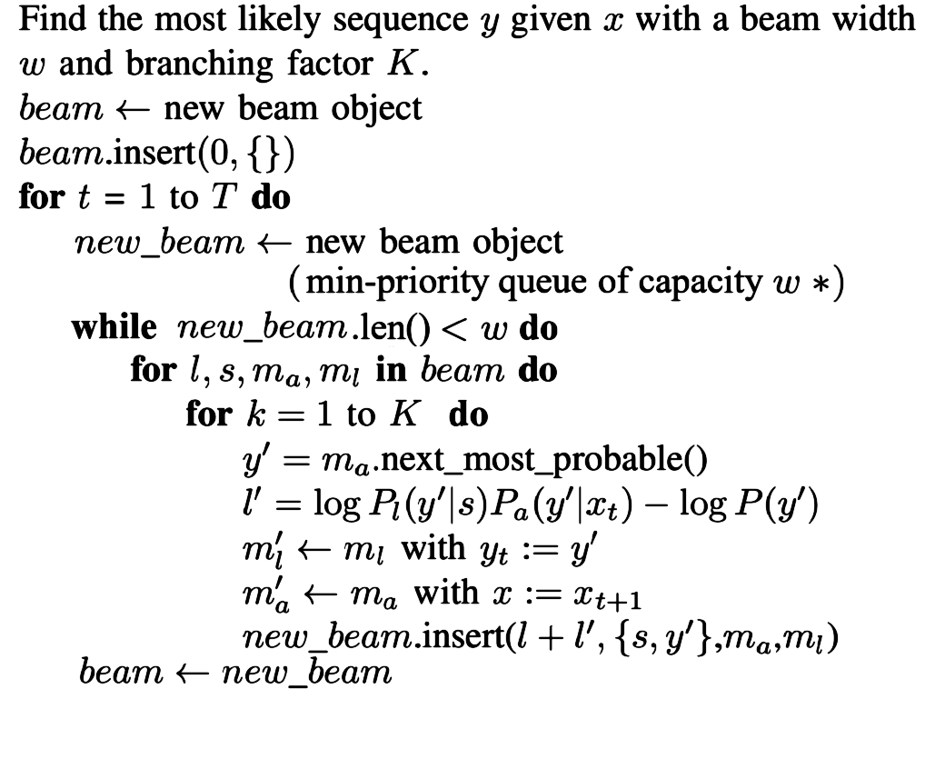
Beam search

Slide 24

Result
2017\MIDI-Unprocessed_070_PIANO070_MID--AUDIO-split_07-08-17_Piano-e_1-02_wav--2
Wav
DNN
RNN
CNN
Truth

Slide 25
Result – Other songs not in testing set
V.K. - 1 Billion Lightyear of Distance
Kreisler-Rachmaninoff: Liebesleid
Marasy8 – Senbonzakura Piano ver.

Slide 26
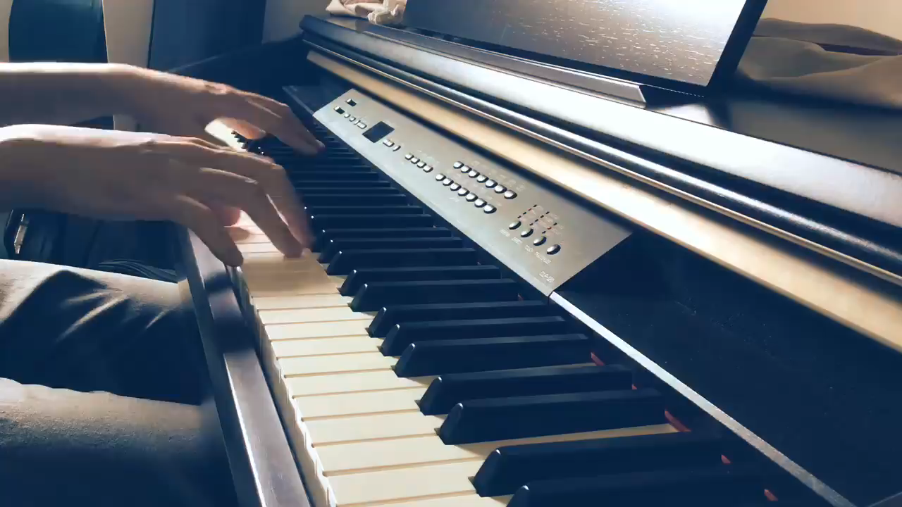
Result – Recording video
Transcription result:

Slide 27
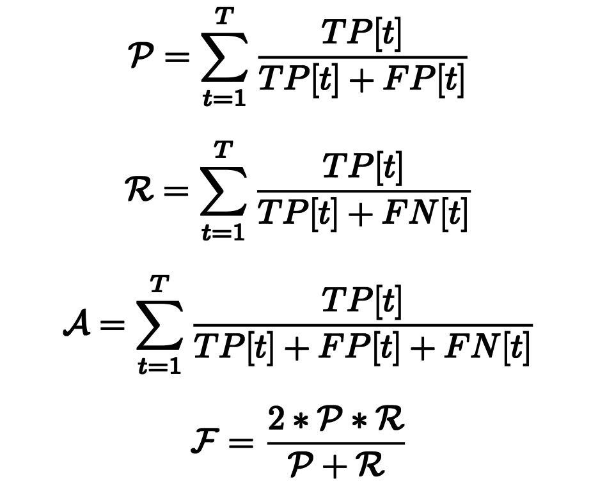
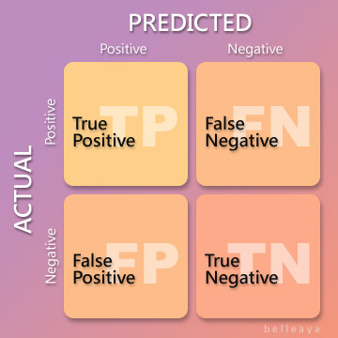
Result – Metrics for acoustic models
F-1 meature for acoustic model(Threshold = 0.5) DNN
DNN: 0.2548693
RNN: 0.6302122
CNN: 0.7372564

Slide 28
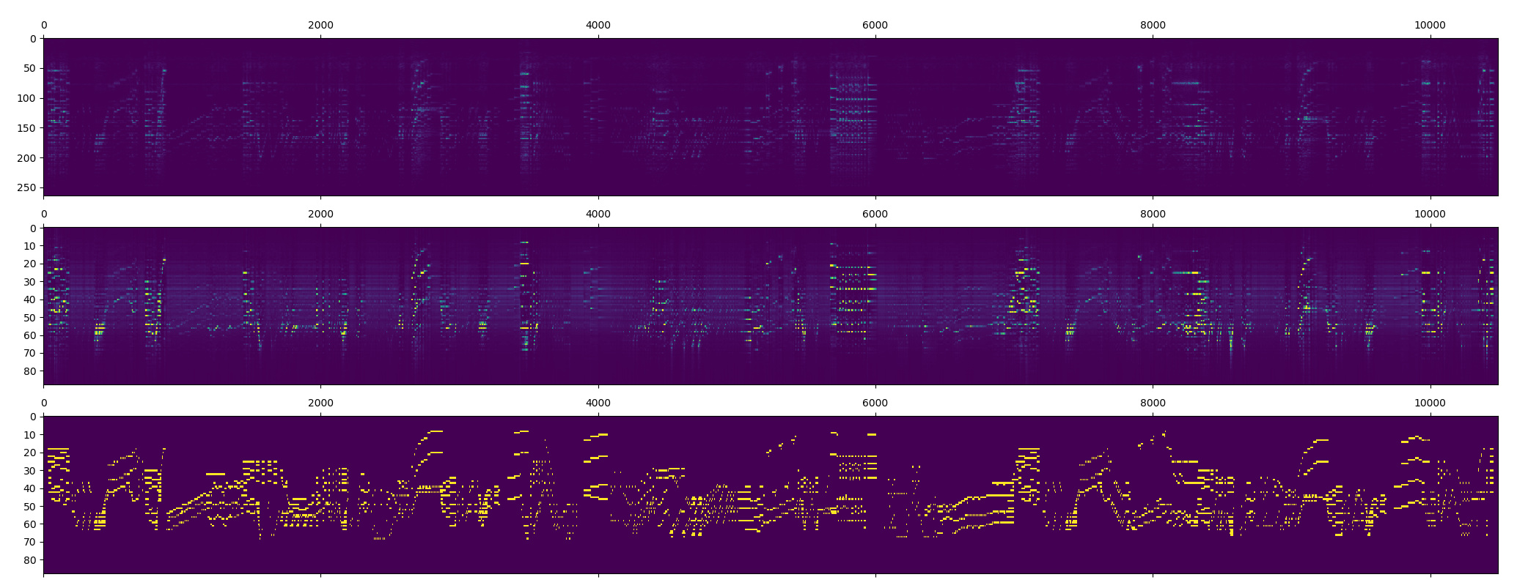
Result – DNN Failed

Slide 30
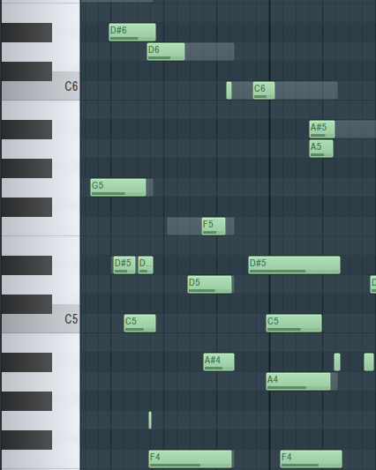
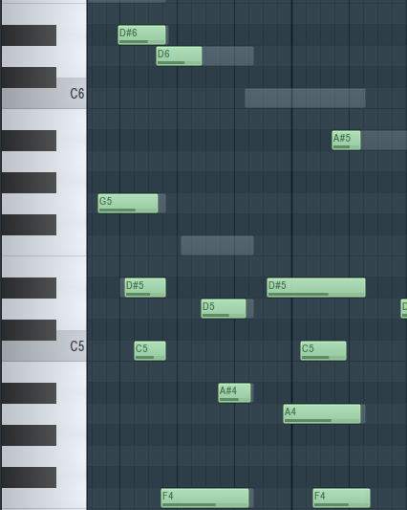
Acoustic Model outputs
Hybrid-structure

Slide 31
Conclusion
Combined with acoustic model and music language model, we can get good results in music transcription, and even apply to piano songs that are not in the test set, such as from albums or recordings.
However, our network will be affected by the audio noise and the recording environment for bad estimating. The network needs to collect more information and other optimization techniques to increase the capability.

Slide 32
Thanks for listening

